Slide 1
Working With Geometry
- Aku Kepingin Menjadi Juara

Slide 2
0511164000032
0511164000068
0511164000099
0511164000118
Irman Kurniawan
Bagus Aji S. S.
Denny Rengganis
Rimba Azhara

Slide 3
Materi yang Akan Dibahas
Two-Dimensional Geometries
THREE.PlaneGeometry
THREE.CircleGeometry
THREE.RingGeometry
THREE.ShapeGeometry

Slide 4
Three-Dimensional Geometries
THREE.BoxGeometry
THREE.SphereGeometry
THREE.CylinderGeometry
THREE.TorusGeometry
THREE.TorusKnotGeometry
THREE.PolyhedronGeometry
THREE.IcosahedronGeometry
THREE.TetrahedronGeometry
THREE.OctahedronGeometry
THREE.DodecahedronGeometry

Slide 5
Two-Dimensional Geometries
Plane, Circle, Ring, Shape

Slide 6
THREE.PlaneGeometry
A PlaneGeometry object can be used to create a very simple two-dimensional rectangle
new THREE.PlaneGeometry(width, height,widthSegments, heightSegments);
Property | Mandatory | Description
width | Yes | This is the width of the rectangle.
height | Yes | This is the height of the rectangle.
widthSegments | No | This is the number of segments the width should be divided into. This defaults to 1.
heightSegments | No | This is the number of segments the height should be divided into. This defaults to 1.

Slide 7
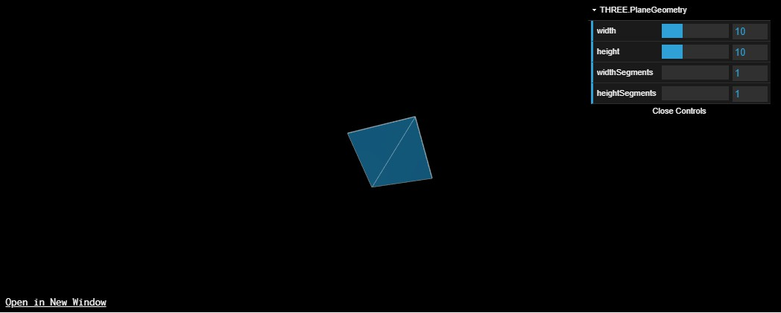

Slide 8
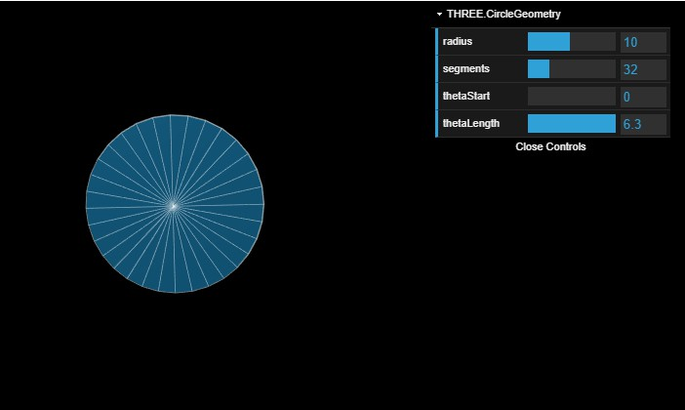
THREE.CircleGeometry
With this geometry, you can create a very simple two-dimensional circle (or partial circle)

Slide 9
Property | Mandatory | Description
radius | No | The radius of a circle defines its size. The radius is the distance from the center of the circle to its side. The default value is 50.
segments | No | This property defines the number of faces that are used to create the circle. The minimum number is 3, and if not specified, this number defaults to 8. A higher value means a smoother circle.
thetaStart | No | This property defines the position from which to start drawing the circle. This value can range from 0 to 2 * PI, and the default value is 0.
thetaLength | No | This property defines to what extent the circle is completed. This defaults to 2 * PI (a full circle) when not specified. For instance, if you specify 0.5 * PI for this value, you'll get a quarter circle. Use this property together with the thetaStart property to define the shape of the circle.
You can create a full circle using the following snippet of code:
new THREE.CircleGeometry(3, 12);
If you wanted to create half a circle from this geometry, you'd use something like this:
new THREE.CircleGeometry(3, 12, 0, Math.PI);

Slide 10
THREE.RingGeometry
With THREE.RingGeometry, you can create a 2D object that not only closely resembles THREE.CircleGeometry, but also allows you to define a hole in the center
THREE.RingGeometry doesn't have any required properties (see the next table for the default values), so to create this geometry, you only have to specify the following:
Var ring = new THREE.RingGeometry();

Slide 11
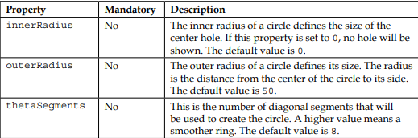
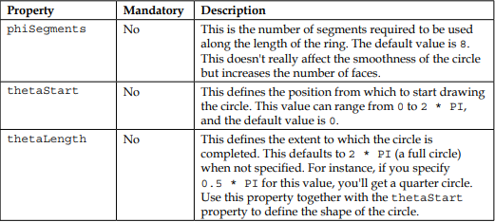

Slide 12
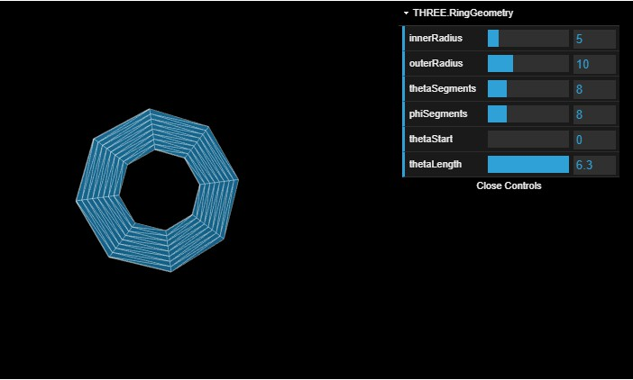

Slide 13
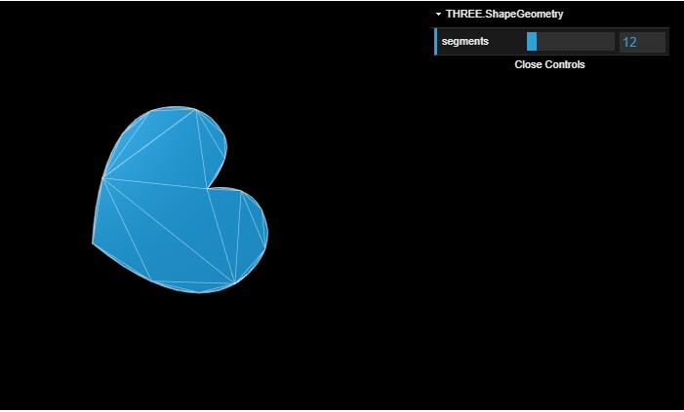
THREE.ShapeGeometry
With THREE.ShapeGeometry, you have a couple of functions you can call to create your own shapes.

Slide 14
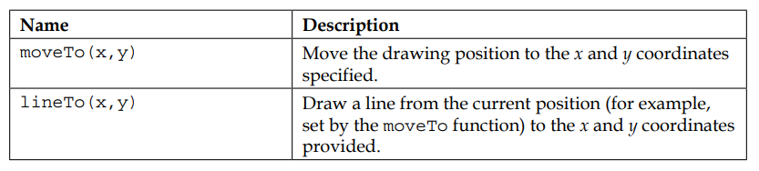
Drawing Functions

Slide 15
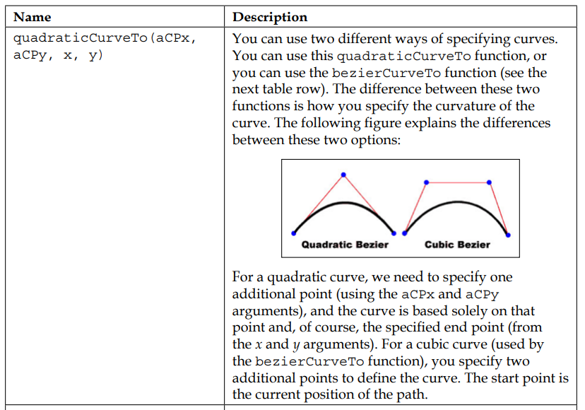
Drawing Functions

Slide 16
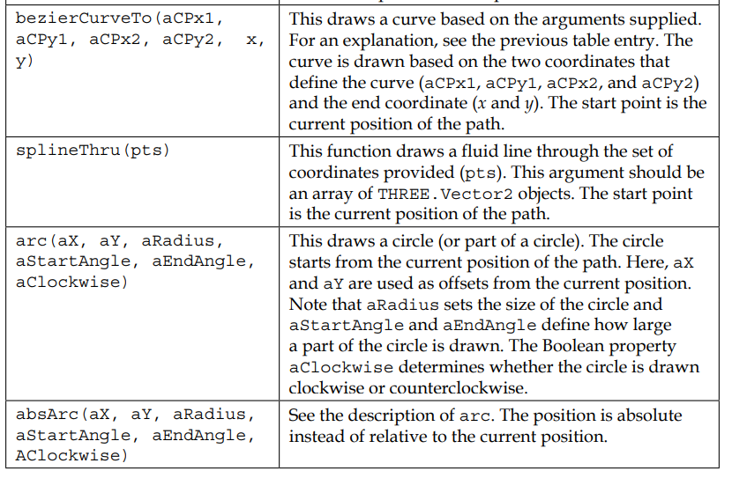
Drawing Functions

Slide 17
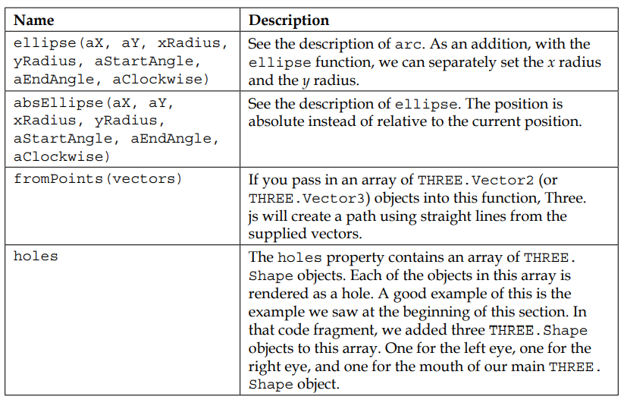
Drawing Functions

Slide 18
Three-Dimensional Geometries

Slide 19
THREE.BoxGeometry
THREE.BoxGeometry is a very simple 3D geometry that allows you to create a box by specifying its width, height, and depth.
new THREE.BoxGeometry(10,10,10);
Property | Mandatory | Description
Width | Yes | This is the width of the cube. This is the length of the vertices of the cube along the x axis.
height | Yes | This is the height of the cube. This is the length of the vertices of the cube along the y axis.
depth | Yes | This is the depth of the cube. This is the length of the vertices of the cube along the z axis.
widthSegments | No | This is the number of segments into which we divide a face along the cube's x axis. The default value is 1.
heightSegments | No | This is the number of segments into which we divide a face along the cube's y axis. The default value is 1.
depthSegments | No | This is the number of segments into which we divide a face along the cube's z axis. The default value is 1.

Slide 20
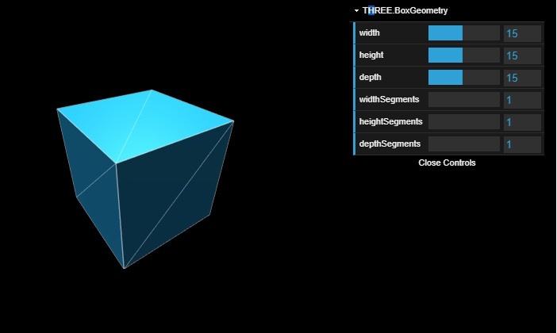
new THREE.BoxGeometry(15,15,15);

Slide 21
THREE.SphereGeometry
With SphereGeometry, you can create a three-dimensional sphere.
Property | Mandatory | Description
radius | No | This is used to set the radius for the sphere. This defines how large the resulting mesh will be. The default value is 50.
widthSegments | No | This is the number of segments to be used vertically. More segments means a smoother surface. The default value is 8 and the minimum value is 3.
heightSegments | No | This is the number of segments to be used horizontally. The more the segments, the smoother the surface of the sphere. The default value is 6 and the minimum value is 2.
phiStart | No | This determines where to start drawing the sphere along its x axis. This can range from 0 to 2 * PI. The default value is 0.
phiLength | No | This determines how far from phiStart the sphere is be drawn. 2 * PI will draw a full sphere and 0.5 * PI will draw an open quarter sphere. The default value is 2 * PI.
thetaStart | No | This determines where to start drawing the sphere along its x-axis. This can range from 0 to PI, and the default value is 0.
thetaLength | No | This determines how far from phiStart the sphere is drawn. The PI value is a full sphere, whereas 0.5 * PI will draw only the top half of the sphere. The default value is PI.

Slide 22
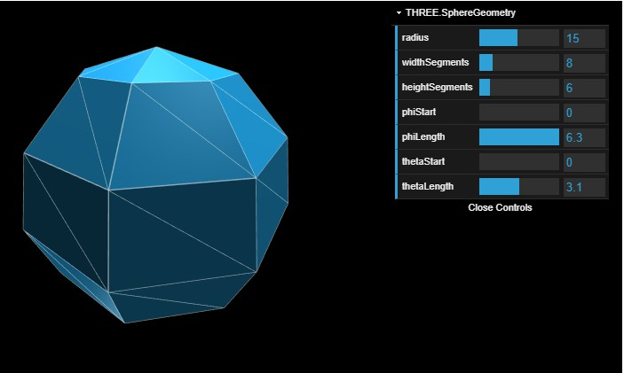

Slide 23
THREE.CylinderGeometry
With this geometry, we can create cylinders and cylinder-like objects.
Property | Mandatory | Description
radiusTop | No | This sets the size this cylinder will have at the top. The default value is 20.
radiusBottom | No | This sets the size this cylinder will have at the bottom. The default value is 20.
height | No | This property sets the height of the cylinder. The default height is 100.
radialSegments | No | This determines the number of segments along the radius of the cylinder. This defaults to 8. More segments means a smoother cylinder.
heightSegments | No | This determines the number of segments along the height of the cylinder. The default value is 1. More segments means more faces.
openEnded | No | This determines whether or not the mesh is closed at the top and the bottom. The default value is false.

Slide 24
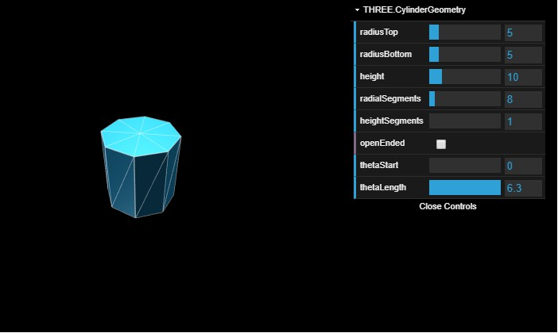

Slide 25
THREE.TorusGeometry
A torus is a simple shape that looks like a donut.
Property | Mandatory | Description
radius | No | This sets the size of the complete torus. Thedefau lt value is 100.
tube | No | This sets the radius of the tube (the actual donut). The default value for this attribute is 40.
radialSegments | No | This determines the number of segments to be used along the length of the torus. The default value is 8. See the effect of changing this value in the demo.
tubularSegments | No | This determines the number of segments to be used along the width of the torus. The default value is 6. See the effect of changing this value in the demo.
arc | No | With this property, you can control whether the torus is drawn full circle. The default of this value is 2 * PI (a full circle).

Slide 26
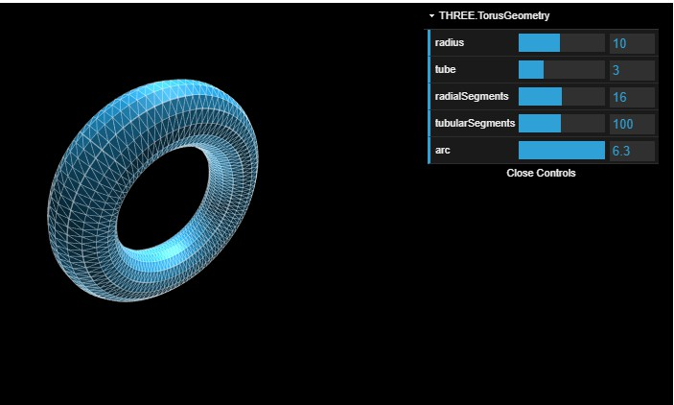

Slide 27
THREE.TorusKnotGeometry
A torus knot is a special kind of knot that looks like a tube that winds around itself a couple of times.
Property | Mandatory | Description
radius | No | This sets the size of the complete torus. The default value is 100.
tube | No | This sets the radius of the tube (the actual donut). The default value for this attribute is 40.
radialSegments | No | This determines the number of segments to be used along the length of the torus knot. The default value is 64. See the effect of changing this value in the demo.
tubularSegments | No | This determines the number of segments to be used along the width of the torus knot. The default value is 8. See the effect of changing this value in the demo.
p | No | This defines the shape of the knot, and the default value is 2.
q | No | This defines the shape of the knot, and the default value is 3.
heightScale | No | With this property, you can stretch out the torus knot. The default value is 1.

Slide 28
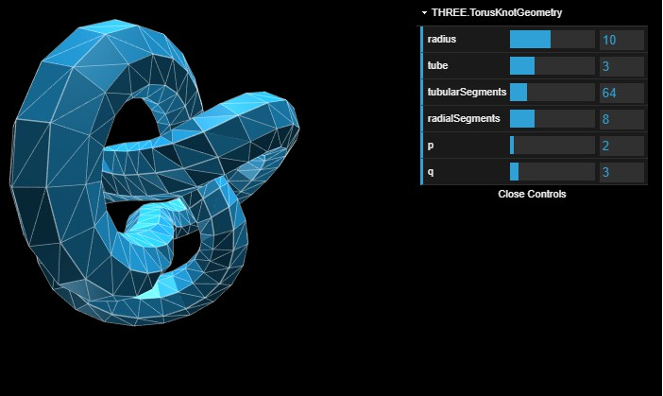

Slide 29
THREE.PolyhedronGeometries
A polyhedron is a geometry that has only ﬂat faces and straight edges.
Most often, though, you won't use this geometry directly. Three.js provides a number of specifc polyhedrons you can use directly without having to specify the vertices and the faces of THREE.PolyhedronGeometry
If you do want to use THREE.PolyhedronGeometry directly, you have to specify the vertices and the faces

Slide 30
Polyhedron Properties
Property | Mandatory | Description
vertices | Yes | These are the points that make up the polyhedron.
indices | Yes | These are the faces that need to be created from the vertices.
radius | No | This is the size of the polyhedron. This defaults to 1.
detail | No | With this property, you can add additional detail to the polyhedron. If you set this to 1, each triangle in the polyhedron will be split into four smaller triangles. If you set this to 2, those four smaller triangles will each be again split into four smaller triangles, and so on.

Slide 31
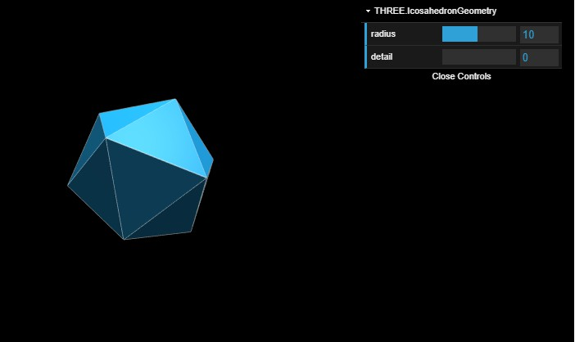
THREE.IcosahedronGeometry
THREE.IcosahedronGeometry creates a polyhedron that has 20 identical triangular faces created from 12 vertices. When creating this polyhedron, all you need to specify are the radius and detail levels.

Slide 32
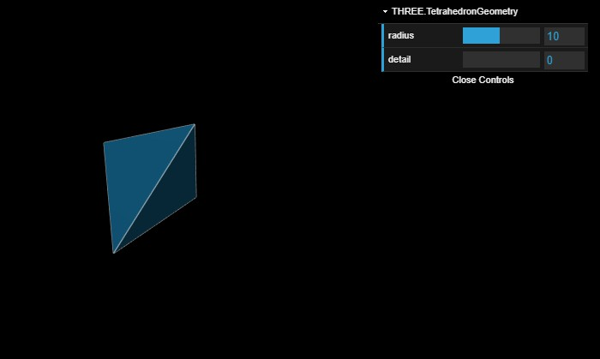
THREE.TethrahedronGeometry
The tetrahedron is one of the simplest polyhedrons. This polyhedron only contains four triangular faces created from four vertices.

Slide 33
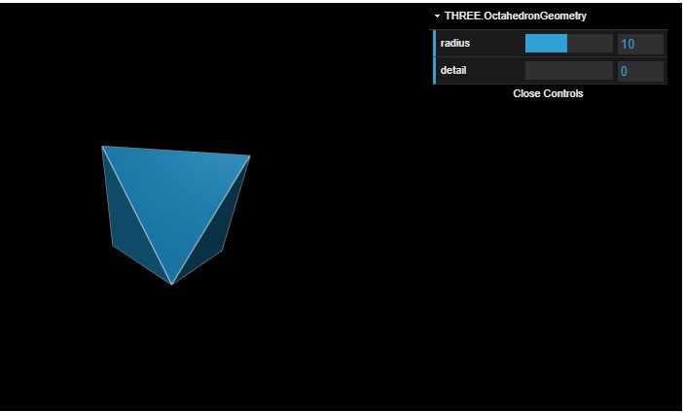
THREE.OctahedronGeometry
Three.js also provides an implementation of an octahedron. As the name implies, this polyhedron has 8 faces. These faces are created from 6 vertices.

Slide 34
THREE.DodecahedronGeometry
The final polyhedron geometry provided by Three.js is THREE.DodecahedronGeometry. This polyhedron has 12 faces.

Slide 35
Terima Kasih

